Slide 1

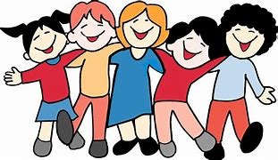
Churwell
Kindness
Ambassadors

Slide 2
Meet the team
Year 1
Emma Schooler
Holly Ford
Year 2
Eliza Bragg
Luna Howe
Year 3
Alice Sullivan
Paige Brearley
Year 4
Gabriel Cleasby
Evelyn Mitton
Year 5
Dexter Hedley
Freya Wilby
Harry Waite
Year 6
Madeline Sutton
Ava Gale

Slide 3
Our Vision
To continue the #BeeKind campaign
To make the school a happier place to be.
For everyone to feel safe and happy.
To reduce unkind behaviour.
To teach children the difference between right and wrong.

Slide 4
Our Role
If children feel upset or sad during breaktime or lunchtime they can come to us and we will help them find someone to play with.
We will ensure that children follow their year group playground pledge.
We will take care of everyone.
We will set termly tasks to help promote our vision.

Slide 5
Speak Out
It is very important if someone hurts your feelings that you tell them.
Sometimes people do not realise that their behaviour is unkind.
If someone hurts your feelings turn to them and say #Beekind.
Alice and Paige will model this.
Doing this you give the person the opportunity to change their behaviour and make better choices. If they continue then you need to SPEAK OUT!!!

Slide 6
Trusted adults – Speak out
Who Are Your Trusted Adults? (Primary Edition) – YouTube
You can speak to any adult in our school – they are here to help

Slide 7

Classroom Task
We would like you all to complete a hand of trust and display it in your classroom.
#BeeKind

Slide 8
#BeeKind
Thank you for listening to us today, we look forward to taking on our new role.
Remember #BeeKind

