Slide 1
Welcome to the Churwell Primary School SEND Coffee Afternoon

Slide 2
What’s to come:
Welcome and introductions
Graduated approach at Churwell
SEND support plans and pupil passports
Assessments for autism, ADHD, dyslexia.
EHCPs and funding
Opportunity to have coffee/biscuits, chat to other parents, visit the different stations
Thank you and feedback forms
Notes:
SENCo – 7 years, Mon-Thurs

Slide 3
Introductions
SENCo
Learning mentors
Inclusion team
Morley cluster

Slide 4
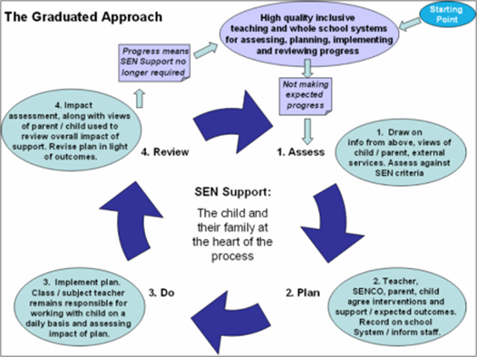
Graduated Approach at Churwell Primary

Slide 5
Definition of SEND
The SEND Code of Practice (2014) states the following, “A child or young person has SEN if they have a learning difficulty or disability which calls for special educational provision to be made for him or her. A young person has a learning difficulty or disability if he or she:
has a significantly greater difficulty in learning than the majority of others of the same age,
or has a disability which prevents or hinders him or her from making use of facilities of a kind generally provided for others of the same age in mainstream schools.”
Special educational provision is educational provision that is additional to or different from that made generally for other children or young people of the same age.

Slide 6
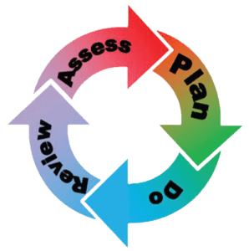
SEND support plans and pupil passports

Slide 7
Assessments for autism and ADHD
CAMHS waiting list times
Right to Choose pathway
What changes once my child receives a diagnosis?

Slide 8
Assessments for dyslexia
Universal provision to support specific learning difficulties
Reading fluency support
Further assessments – speed of processing, phonological awareness and verbal memory
What changes once my child receives a diagnosis?

Slide 9
Education, Health and Care Plans
https://www.youtube.com/watch?v=WGw0OmXo_uw

Slide 10
Education, Health and Care Plans (EHCPs)
SENDIASS say:
A legal document for children and young people aged from 0-25 with Special Educational Needs and Disabilities (SEND) who need more support than their school can provide under SEND support.
If you feel that your child needs more support than their school can provide or is going to need a higher level of support as they go through their education, then you can ask for an EHC Needs Assessment.
There must be evidence of at least two terms of the graduated approach
Parents can request an EHC assessment
Specialist settings – you must have an EHCP

Slide 11
Visit our different stations
SENCo
Learning mentors
Inclusion team
Morley cluster
Feel free to help yourself to tea/coffee and biscuits
Please chat to other Parents/Carers and share your experiences, questions or advice.

Slide 12
Thank you
Any questions?

