Slide 1
Zones of Regulation
How this is used at Churwell Primary Academy

Slide 2
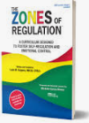
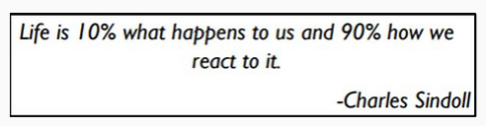
What are The Zones of Regulation?
The Zones of Regulation is a programme created by an occupational therapist used to help children and young people regulate their emotions and needs.
.
Using The Zones of Regulation helps children to identify emotions, what they look like, and then use tools to help them manage situations.
Notes:
One of the great benefits of The Zones of Regulation is that it gives children a way of talking about their emotions- something as adults we can find hard!
Enables and empowers children to independently manage their emotions and behaviour more effectively

Slide 3
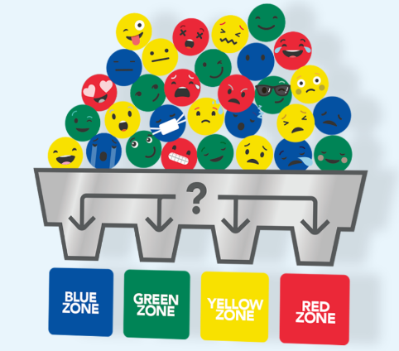
Feelings are complicated.
They come in different sizes, intensities, and levels of energy that are unique within our brains and bodies.
To make them easier to talk about, think about, and regulate. The Zones of Regulation organises our feelings, states of alertness, and energy levels into four coloured Zones
Blue, Green, Yellow, and Red
Notes:
Feelings are complicated.
To make them easier to talk about, think about, and regulate, The Zones of Regulation organises our feelings, states of alertness, and energy levels into four coloured Zones
Blue, Green, Yellow, and Red.

Slide 4
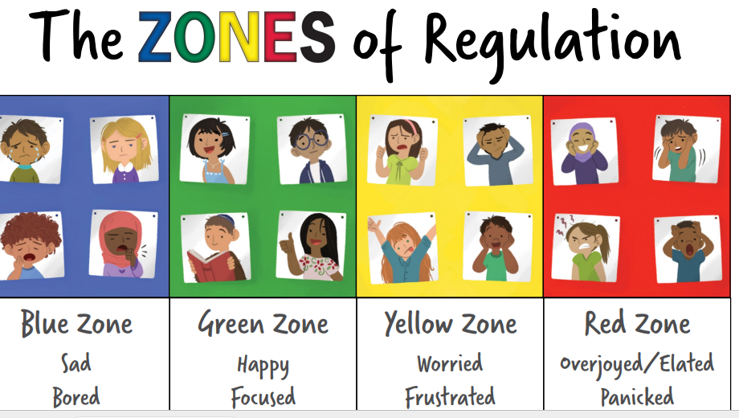
Which Zone are you in?
Children will have the opportunity to identify which zone they are in at different points of the day.
Notes:
We praise children when they identify which zone they are in even if it is the red zone.
The simple, common language and visual structure of The Zones of Regulation helps make the complex skill of regulation more concrete for learners and those who support them.

Slide 5

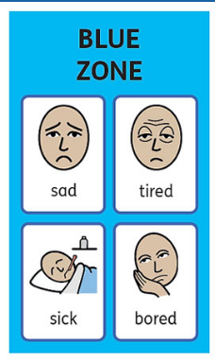
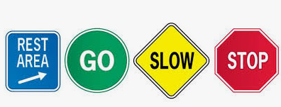
The Blue Zone
The blue zone is when a person is feeling low states of alertness.
This can also be known as the ‘rest area where you pull over as you are tired and need to recharge’ or ‘moving slowly’.
Examples of being in the Blue Zone could include:
Feeling tired
Feeling unwell
Fall out with friends
Notes:
Example of when someone might be experiencing the blue zone is
• First thing in the morning
• Last thing before bed
Not feeling well
Fall outs with friends

Slide 6

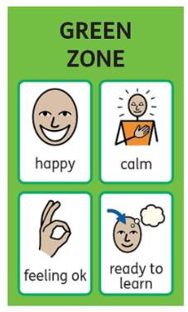
The Green Zone
The green zone describes when you’re in a calm state of alertness.
This can also be known as ‘good to go’ or ‘just right’.
This is the zone where optimal learning occurs and feel a strong sense of control.
The Green Zone links well with our ‘Good to be Green’
Notes:
The Green Zone links well with our ‘Good to be Green’

Slide 7
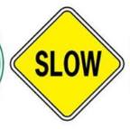
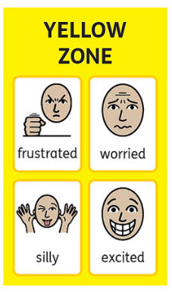
The Yellow Zone
The yellow zone describes when you have a heightened sense of alertness.
This isn’t always a bad thing, and you still have some control of your actions when you’re in the yellow zone.
This can also be known as ‘caution or slow down’
Examples of being in the Yellow Zone could include:
It’s your Birthday
Your work is challenging and you are finding it difficult’
‘First time trying something new’
Notes:
Examples of being in the yellow Zone could be
‘Its your birthday’
‘Your work is challenging and you are finding it difficult’
‘First time trying something new’

Slide 8

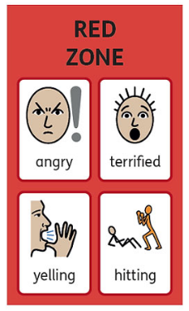
The Red Zone
The red zone describes an extremely heightened state of intense emotions.
This can also be known as ‘moving very fast’ or ‘stop and regain control’
Examples of being in the red zone could include:
Something hasn’t gone your way
Someone has upset you
You are feeling frightened
You are hurt
Notes:
Examples of being in the red zone could include
Something hasn’t gone your way
Someone has upset you
You are feeling frightened
You are hurt

Slide 9
The Four Zones
The Zones can be likened to traffic lights.
Rest area where you
pull up and recharge
‘you are good
to go’
Slow down,
caution
Stop, regain control
and recharge
No zone is ‘good’ or ‘bad’.
We all routinely experience several of the zones across the day.
Notes:
All the Zones are Okay
The Zones can be likened to traffic lights.
Blue- Rest area where you pull up and recharge
Green- ‘you are good to go’
Yellow- Slow down / caution
Red- Stop and regain control, recharge
It’s critically important that we don’t convey the message that the Green Zone is the only acceptable Zone to be in.
Acknowledge, accept, and support these feelings, never make anyone feel like the Green Zone is the norm.

Slide 10
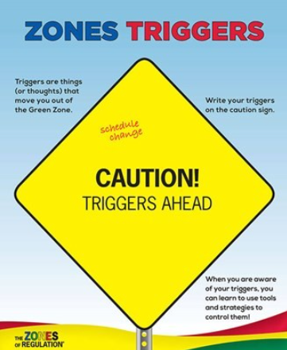
Caution Triggers Ahead!
Sometimes things happen to make you feel worried, upset, or frustrated!
The Zones of Regulation helps identify and understand emotions, but it also encourages recognition of triggers and provides strategies for emotional regulation.
Feelings vs behaviours is introduced to children to explain how all emotions are ok
but it’s how we deal with and cope with them which helps control our behaviour
Notes:
We all encounter trying circumstances that can test our limits. If we can recognise when we are becoming less regulated, we are able to do something about it to manage our feelings and get ourselves to a healthy place.
Identifying triggers is often difficult for many children, especially those who may struggle with regulation, so it may be

Slide 11
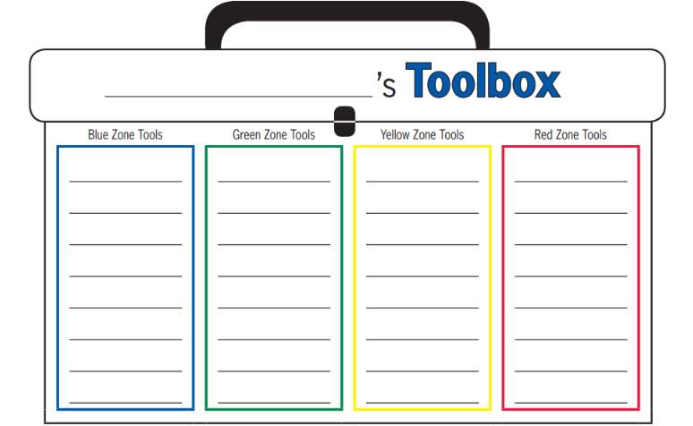
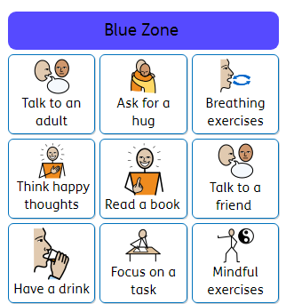
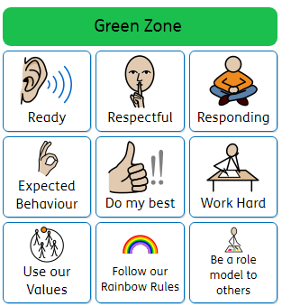
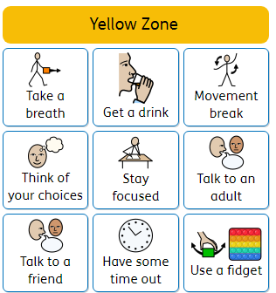
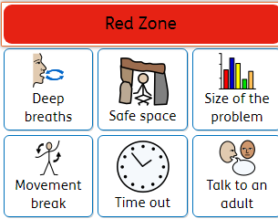
The Zones of Regulations
Positive thinking (inner coach-
”You can do it”.
Drink water
Stretches
Star jumps
Eat something
Stay focussed
Ready
Respectful
Responding
Positive thinking (inner coach-”You can do it”.
Think about the size of the problem
Stretches
Star jumps
Eat something
Safe Space
Time out
Talk to an adult
Eat something
Movement break
Once children can identify triggers, they are encouraged to find a 'tool' to help support them with self- regulation.
Notes:
Once children can identify triggers, they are encouraged to find a strategy/ 'tools' to support with self- regulation.
Not all children will use the same tool to support with self-regulation and may ‘try out’ lots of them before finding a strategy that supports them.

Slide 12
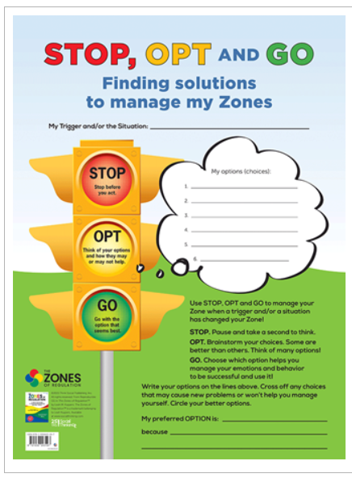
Helping us manage in the zones
Providing children with options to STOP, OPT and Go helps support them to manage whilst in a particular zone.
STOP!-Take a second to think.
Opt - Think about your choices-Some will be better than others.
GO - Choose which option/ tool helps you manage …
Notes:
Zones supports children to feel comfortable and in touch with their emotions. Providing them with options to STOP, OPT and Go to support them to manage whilst in a particular zone.
STOP!-Take a second to think.
Opt - Think about your choices.-Some will be better than others.
GO - Choose which option/ tool helps you manage …

Slide 13
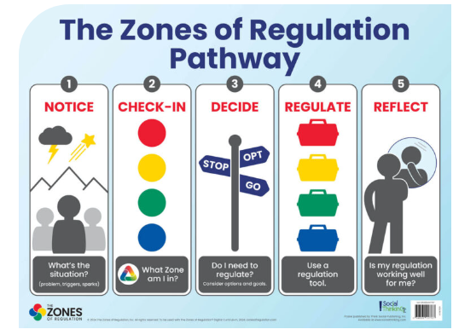
Notice:
What is the situation?
Check-in: What Zone I’m I in?
Decide:
STOP, OPT, GO
Do I need to
regulate?
Regulate:
Use regulation tool
Reflect:
Is my regulation working well for me?
Notes:
A recap The Zones of Regulation Pathway,

Slide 14
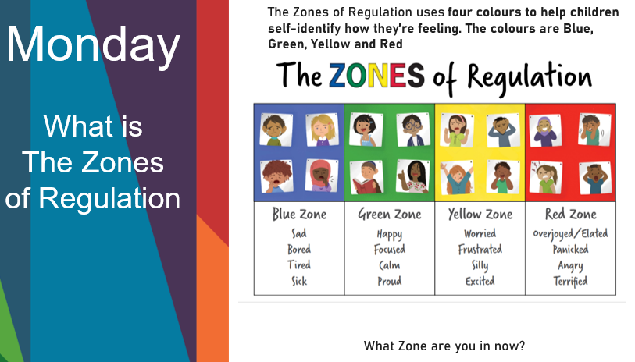
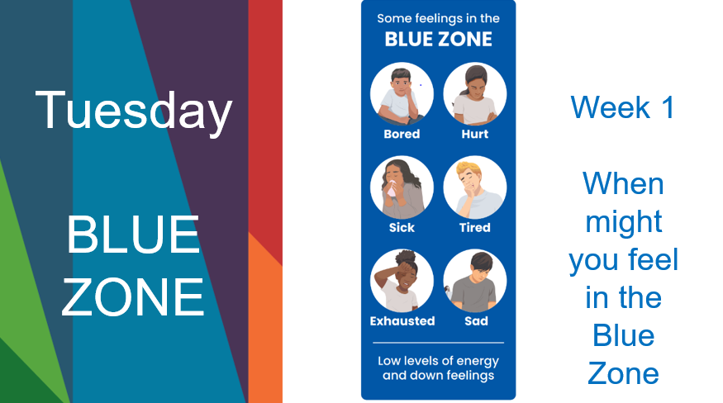
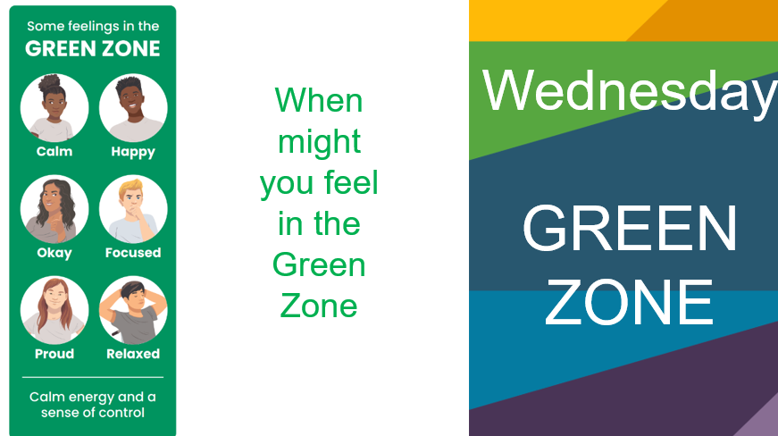
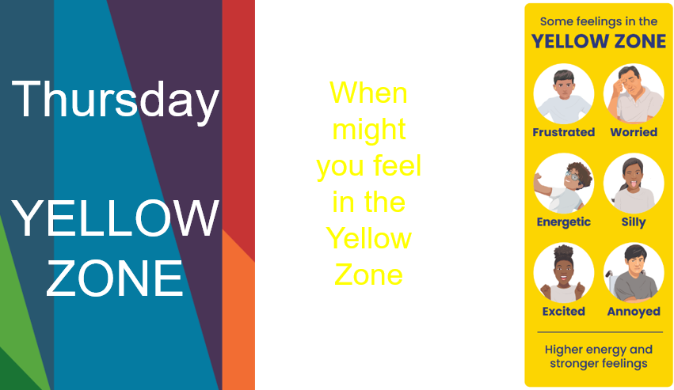
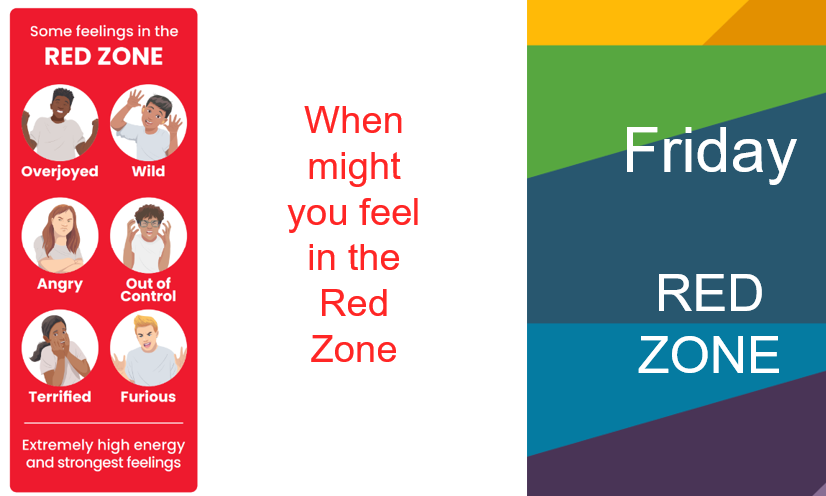
In The Zone Check in example
Monday- overview and recap.
Tuesday- Blue Zone.
Wednesday- Green Zone.
Thursday- Yellow Zone.
Friday- Red Zone.

